Slide 2
Architecting .NET Microservices in a Docker Ecosystem
Hamida REBAI
(Microsoft MVP in Developer Technologies)

Slide 3
Table of content
Monolithic vs Microservices Architecture
Microservices architecture and Patterns
Docker container
Microservice using ASP.NET Core
Deploy a microservice to Azure
Orchestrators in Azure

Slide 4
Monolithic vs Microservices Architecture

Slide 5
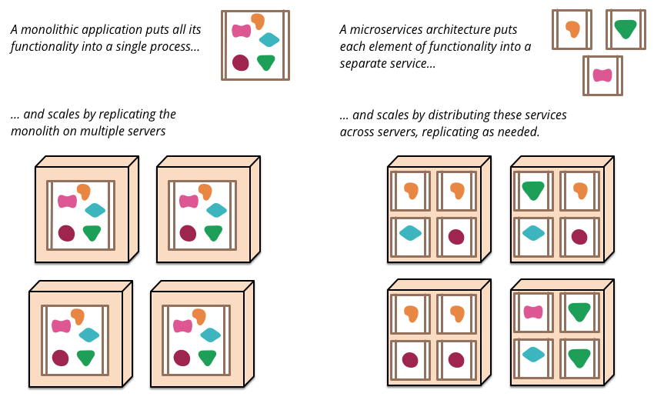
https://martinfowler.com/articles/microservices.html

Slide 6












Monolithic application approach
Microservices application approach
Presentation Layer
Desktop & Mobile
apps
Web apps
Services tier
API Gateway
Business logic Layer
Microservices
SQL DB
or
No-SQL
SQL
[…]
No-SQL
[…]
Stateful service
Database access Layer
Monolithic Databases are shared across services.
Each microservice owns its model/data!

Slide 7
Microservices architecture and Patterns

Slide 8
Patterns | Technologies
Microservices
Docker Containers
Autonomous
Bounded Context
Linux Containers
Docker Image
Nomad & addressable services
Isolated
Docker Host
API Gateway
Windows Containers
Docker Registry
Decoupled
Docker Hub
Events
Async. communication
Hyper-V Containers
Event Bus
Message Brokers
Azure Service Bus
Azure Container Registry
Service Discovery
Health Checks
Orchestrators
Transient Failures Handling
Resiliency
Azure Service Fabric
Stateful Services
Commands
Actors
Retries with Exponential Backoff
Azure Container Service
Domain-Driven Design
Circuit Breakers
RabbitMQ
CQRS simplified
Kubernetes
NServiceBus
Aggregates
Docker Swarm
MassTransit
Domain Entity
Domain Events
Mesos DC/OS
Brighter
Mediator
Polly

Slide 9


Microservices architecture style
Identity
Provider
Microservices
Client
Remote Service
Service 1
API Gateway
Service 2
Service 3
Service 4
Management
Service Discovery
CDN
Static Content

Slide 10


API gateways in microservices
Client
Routing
SSL Offloading
Service 1
API Gateway
Service 2
Authentication
Response caching
Logging
Identity provider

Slide 11
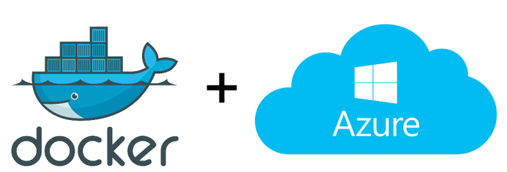
Docker container
Notes:
Docker is a tool that makes it easier to create, deploy, and run applications by using a containerization approach. These containers are lightweight and take less time to start than traditional servers. These containers also increase performance and lower cost, while offering proper resource management. Another benefit to using Docker is that you no longer need to pre-allocate RAM to each container.

Slide 12
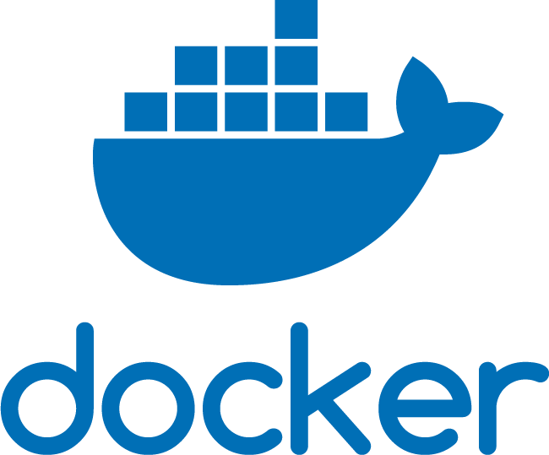
Docker
Technology that allows the creation and use of containers.
Tool that allows developers and sys-admins to easily deploy their applications in a sandbox (containers) to run on the host operating system i.e. Linux.
Notes:
Docker is a technology that allows the creation and use of containers, basically it is a tool that allows developers and sys-admins to easily deploy their applications in a sandbox (containers) to run on the host operating system i.e. Linux.

Slide 13
Microservice using ASP.NET Core
Notes:
Designing resilient distributed microservices systems
Implementing microservices
Microservices communication
Monitoring microservices
Securing microservices

Slide 14

Prerequisites Environment
Windows 10 is required for Docker installation.
Visual Studio 2019 or 2017 has built-in support for Docker
.NET Core SDK
Docker for Windows
Docker Tools

Slide 15
Creating an Asp.NET Core 3 Application Solution

Slide 16
Deploy a microservice to Azure
Notes:
Deploying microservices

Slide 17
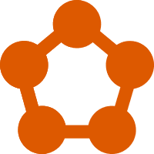
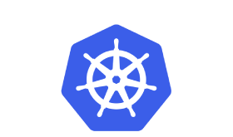
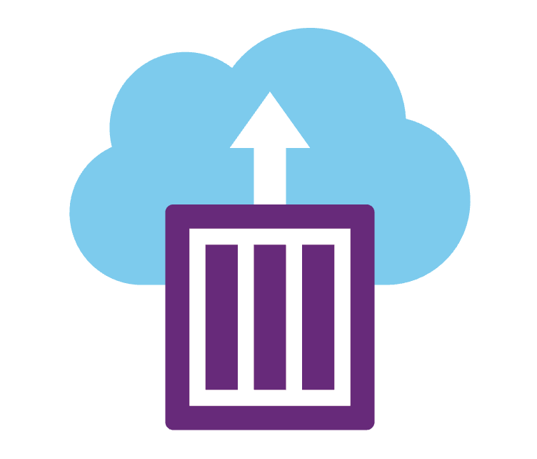


Containers in Azure
App Service
Service Fabric
Kubernetes Service
Container Instances
Batch

Slide 18
Push Docker images to Azure Container Registry

Slide 19
Orchestrators in Azure

Slide 20





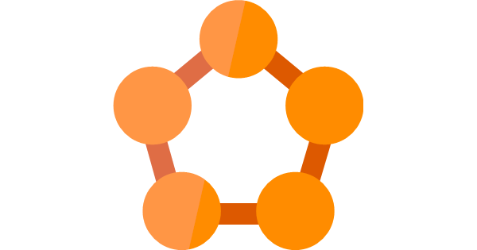
Orchestrators in Azure
Azure Product
Orchestrator / Engine | Description | Good for | Common workloads
 | Kubernetes is an open-source platform for automating deployment, scaling, and operations of application containers across clusters of hosts. AKS: You pay for VMs in cluster ACS Engine: IaaS container infrastructure |  | Microservices based on containers
 | Azure Service Fabric is a distributed systems platform that makes it easy to package, deploy, and manage scalable and reliable microservices. Mesh: PaaS/Serverless platform Cluster: You pay for VMs in cluster |  | Microservices based on containers Microservices based on plain processes Stateful services
Azure Kubernetes Service
(AKS)
Kubernetes
It’s an OSS ecosystem
More mature:
Less mature:
Azure Service Fabric
(Mesh and cluster)
Service Fabric
It’s a Microsoft ecosystem
and OSS
More mature:
Less mature:

Slide 21
Conclusion
Microservices allow to evolve, deploy and scale parts of the application independently.
Microservices offer great distributed software challenges.
Microservices is for large, scalable and long-term evolving applications.

Slide 22


Hamida REBAI @rebaihamida https://github.com/didourebai/

Slide 23

HttpClient factory
Client application/code
IHttpClientFactory
Dependency Injection
ClientService
Pool
(i.e. CatalogService)
HttpMessageHandler
instances
Http
endpoint
HttpClient
(Configured)
Policies
Controller or client code
Delegating
Handlers

